Slide 1
Urban MODs GIS tutorial
Natalie Schultz & TC

Slide 2
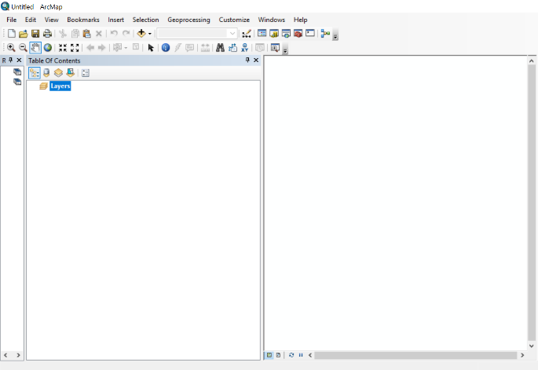
Getting Started…[1/2]
Start ArcMap.
Close the ArcMap – Getting Started window.
Tools and Menus
Table of contents
Data Frame Window

Slide 3
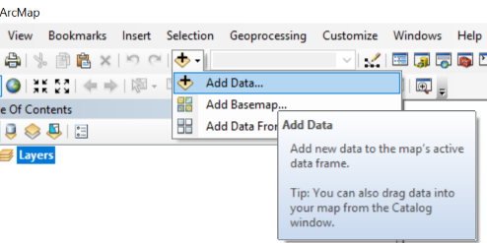
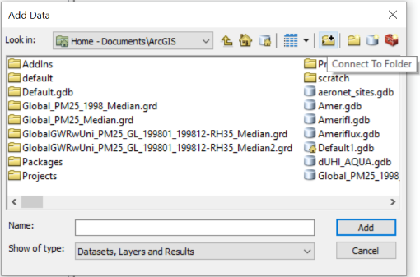
Getting Started…[2/2]
Click on Add Data
Choose Connect to Folder
Choose the folder where you downloaded all the material

Slide 4
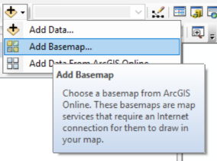
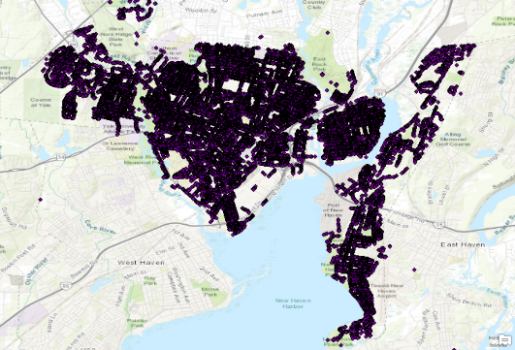
Adding data
Select the Trees_new.shp file
Add a basemap to your workspace

Slide 5
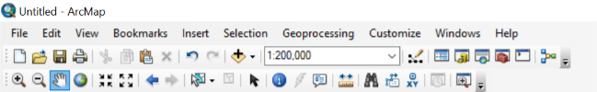
Exploring and inspecting data
Zoom in and out
Select and clear
Pan
Identify
Full
extent
Html popups, Measure, Find, Find routes, Go to coordinates, Time slider, Create viewer window
Fixed zoom in and out
Select element
Hyperlink
Switch between extents
Notes:
Use the functionality on the trees data; towards the end, use the identify tool to show the properties of one single tree point; note the DBH, since we will visualize that in the next segment. Also go to the main file and talk about the attribute table, which lists all the properties for all the points (features).

Slide 6
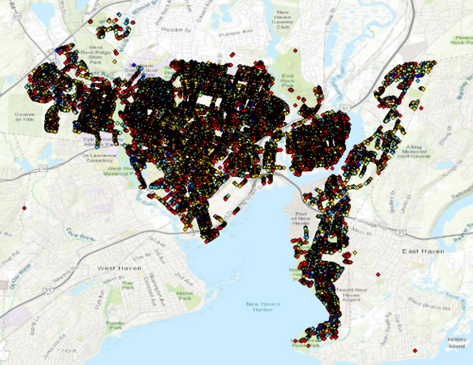
Visualizing data
Right click on trees layer on the contents window
Go to Layer Properties
Go to Symbology tab
Go to Quantities>Graduated Symbols>choose DBH as the value
Apply
Notes:
The number of points may be more than the maximum points displayed by default in ArcMap; to fix this, from the graduated colors tab, go to classify>sampling and then change the sample size to more than the total samples in the layer (use the attribute table to look at the total number of features in that collection)

Slide 7
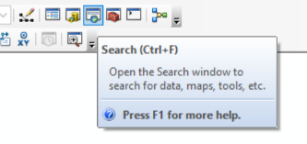
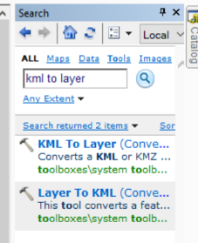
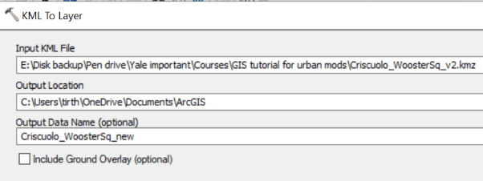
Converting between data types
Open the search tab
Search for KML to Layer
Select one of the route files (.kmz)
Run the tool
Right click on created polyline
Go to Data>Export Data
Export as .shp file

Slide 8
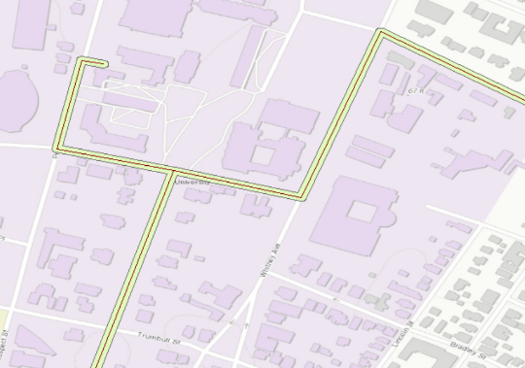
Buffering
Search for the buffer tool
Use the shapefile you just created as an Input Feature
Save the output feature as a .shp file
Change distance option to 20-50 feet
Change Method to Geodesic
This will be our region of interest for the next exercise
Notes:
Play around with the width based on the tree data such that you get the line of trees along the roads

Slide 9
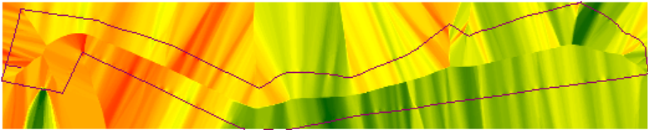
Converting from vectors to rasters
Input the Bike_Temp.shp file
Search for IDW (Spatial Analyst) to create a continuous raster surface from the vector data
Input the Bike_Temp data as the input features
Choose the temperature column as the Z field value (Air_Temperature)
Run the tool
Note that we will have large biases away from sampling points

Slide 10
Aggregating data to region of interest
Select the Clip (Data Management) tool
Use the interpolated raster as the input raster
Choose the buffered route as the extent
Check Use input features as clipping geometry to get exact clipping within the buffered route
Run the tool
Select the Clip (Analysis) tool to aggregate the street tree data to the same buffered route

Slide 11

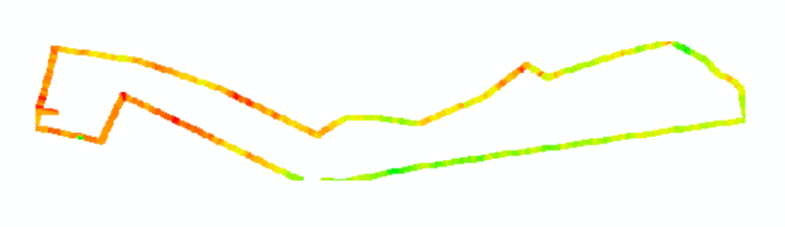
Comparing street tree frequency with air temperature
Does this make sense?
Why or why not?
Discuss
Street tree locations
Air temperature
(red indicates higher values)
Notes:
Note that the redder values are higher because it is nearer to the center of the city;
while trees do locally reduce temperature, the temperature is also dictated by macro factors, in this case, proximity to urban core, and thus, heat built up, anthropogenic heating, etc.
Theoretically, if you had removed those trees from the urban core, the temperature would have been even higher
It’s hard to perform this kind of analysis purely from observations due to the presence of such confounding variables

Slide 12
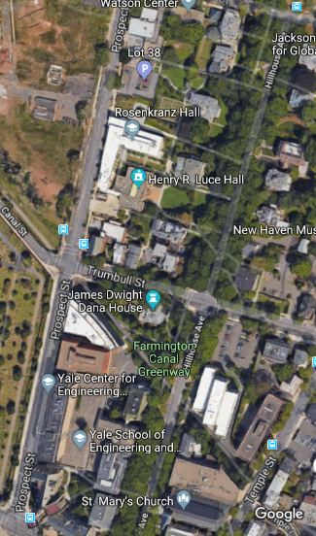
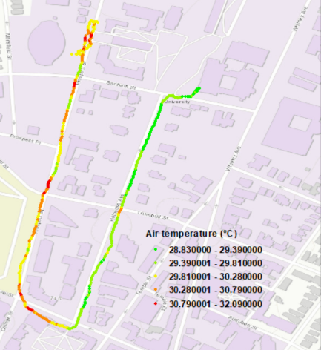
An apples to apples comparison
Notes:
Reserved for a comparison slide between Hillhouse and Prospect

Slide 13
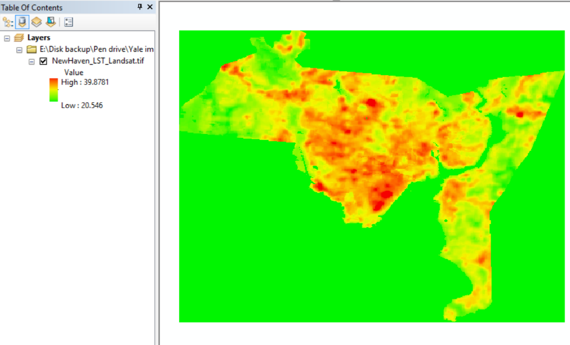
Scaling up our analysis using satellite data
Add the NH_Census.shp data
Load NewHaven_Landsat_LST.tif
Improve the visualization using the Color Ramp options (the black and white gradient bar in the Table of Contents)

Slide 14
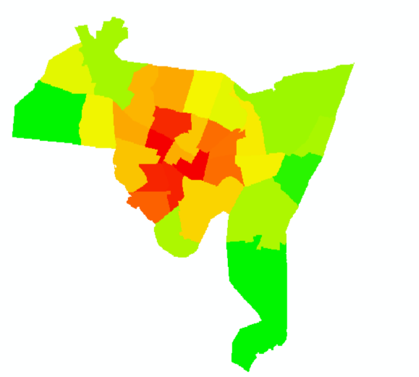
Zonal Statistics
Search for Zonal Statistics as Table toolbox
Use the Census tract as the feature zone layer
Use the LST data as the Input value raster
The zone field can be any of the columns with unique values
You can change the statistics type if you want (use mean for now)
Run the tool
Repeat the process with NewHaven_Landsat_NDVI.tif
Result from Zonal Statistics

Slide 15
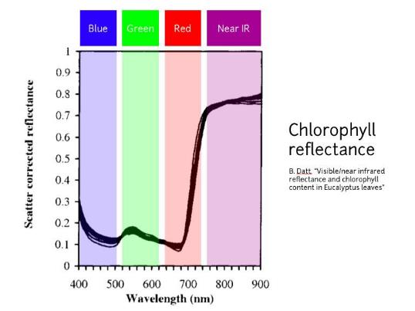
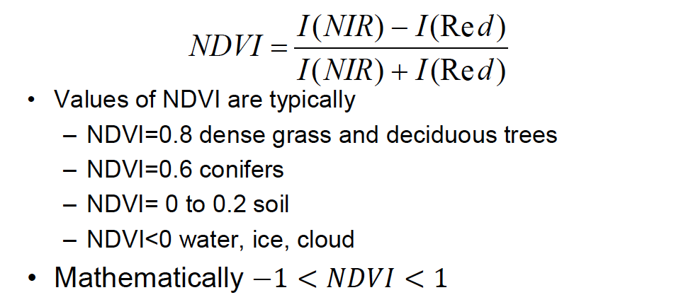
What is NDVI?
Normalized Difference Vegetation Index
Notes:
Talk about NDVI, unless you want to do it earlier in the introduction

Slide 16
Renaming fields
Since both the NDVI and LST tables have a ‘MEAN’ field, rename them to prevent overwriting for the next step
Right click and open the table
Right click on the ‘MEAN’ field
Click on the properties
Change the MEAN fields to LST_MEAN and LST_NDVI, respectively

Slide 17
Joining different data types
Right click on NH_Census.shp and select Join and Relates
Click on Join
Choose the GEOID10 field from the shapefile
Select the LST table created using the zonal statistics tool
Select its GEOID10 field and perform the join
Do the same for the NDVI table

Slide 18
Joining income data from an Excel Sheet
Add the Income_cleaned.xlsx file to ArcMap
Select Join and Relates on the New Haven census shapefile
Select the xlsx layer to join to this shapefile
Choose the GEO.id2 for this layer as the join field
Now you have joined the census data with the census tract feature collection that already contain the mean satellite data

Slide 19

Creating a publishable map
Select the LST or NDVI image
Move from Data View to Layout View
Select Insert option from the upper left corner
Insert Title, Scale bar, North Arrow, and Legend
Classified versus Stretched Legend options
Export Map as a .pdf file
Notes:
Tell them about editing options to improve the legend; like change the default legend ranges; edit the weight and font size of title, etc.

Slide 20
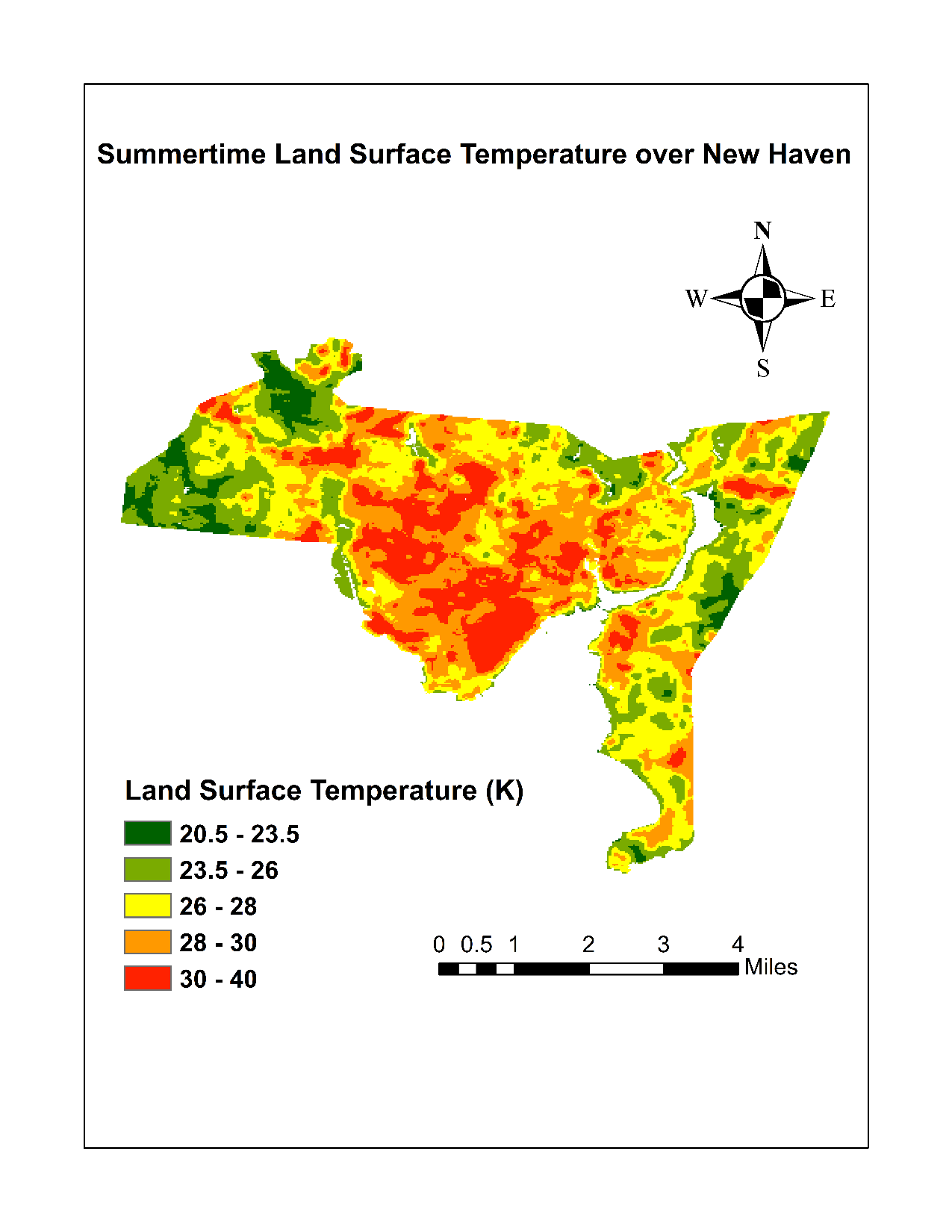
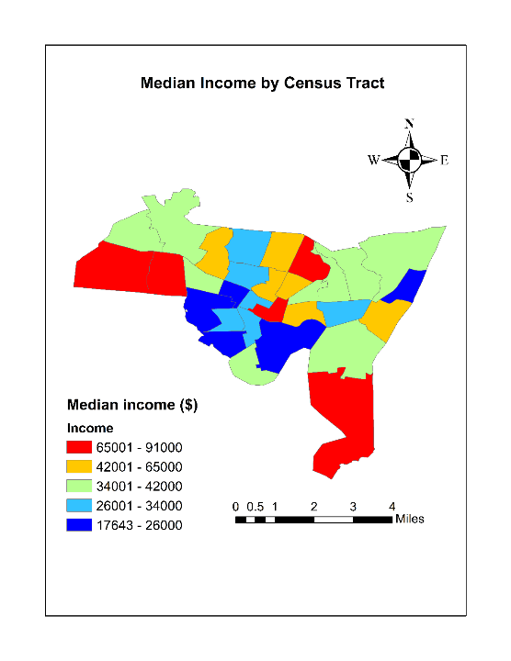
Notes:
If, while classifying the raster for displaying, you get a too many values error, first clip the raster to the NH census tract data

Slide 21
Exporting data and further analysis
Search for the Table to Excel toolbox
Save the output file in an accessible location
Open the Linearmodels.R code in the downloaded directory
Notes:
Mention that you can perform scatterplots using ArcMap, but they look like shit or take too much work+we want to use Open Source as much as possible

Slide 22
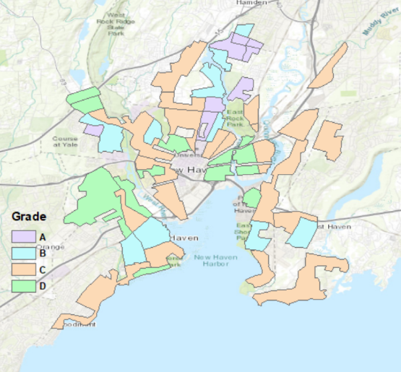
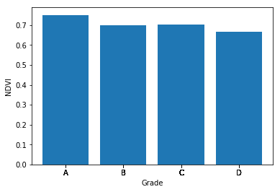
Choosing different regions of interest: Redlining case
Link to the Dexter Locke paper?

Slide 23
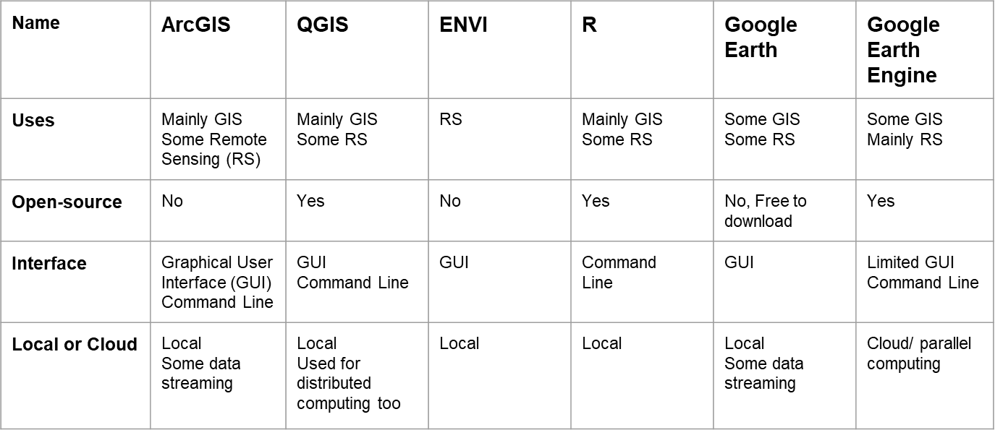
GIS and RS Platforms and Software

Slide 24
GIS and RS resources at Yale

